Slide 1



Archi Modeling in ArchiSurance

Slide 2
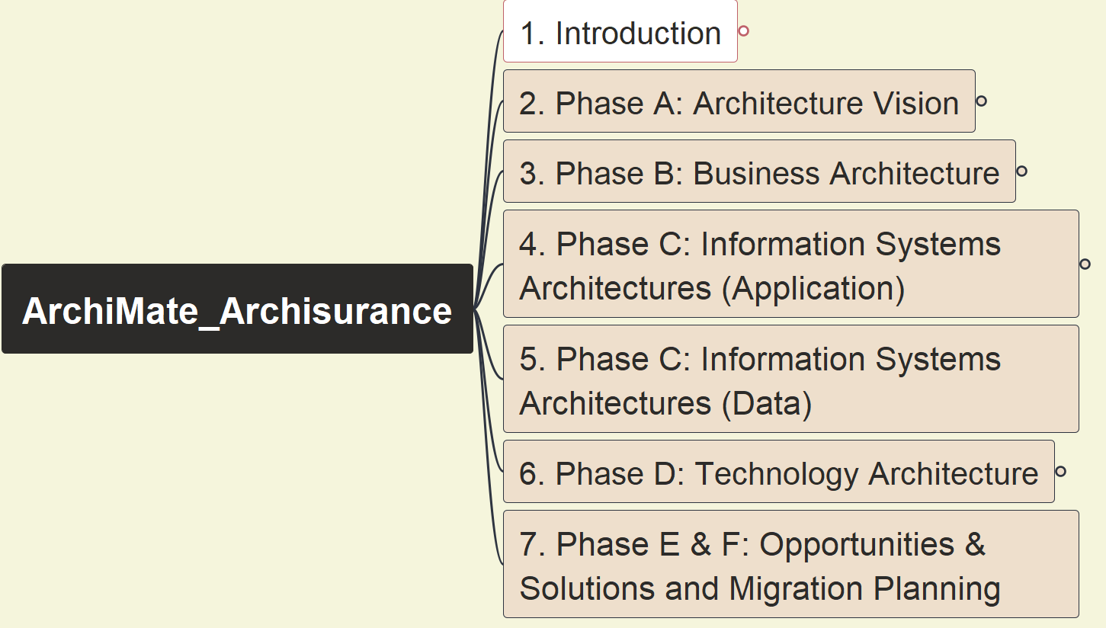
Opening and Course Introduction
ArchiSurance 2025
001

Slide 3

About Me – Xiaoqi Zhao (and archi. Related)
25+ years in IT field, 10+ years as Enterprise Architect
ITIL Manager in 2002, PMP in 2003
OpenGroup TOGAF 9 Certified in 2013
ArchiMate 3 Certified in 2021
Gain OpenGroup Level 2 Architect in 2021 as well
Skillful on Architecture Abstracting and Modeling
Actively using EA tools, diagramming tools
Learn by doing, share by practicing… also for FUN!

Slide 4
Why This Course – ArchiSurance 2025
I had packaged and shared ArchiSurance Practice in 2023, gained interests by variable architect roles
46 Videos, Viewed 20K+ times, 730 hours
The course was selected into Udemy Business in Q4 2024, and as the only one relating to “ArchiSurance” topic there, ~ 400 students
Since that series of demo were based on mixed version 3.1 and 3.2, and have collected numerous feedbacks from students, I’d like to develop one new version of this course fully basing on version 3.2, also, take chance to improve the course recording technic
Archi tool has been upgraded to v5.5.0 with fully complying with ArchiMate 3.2, which will be used in the new course

Slide 5
Key Learning Information for your Aware
Course structure will be managed in Mindmap via FreePlane tool
Every lecture aims to finish one view
Gradually build up Enterprise Architecture Repository for ArchiSurance
Generate and archive one snapshot model right after every view modeling
Models and information is tracked in new GitHub repository: https://github.com/yasenstar/ArchiMate_ArchiSurance
Do not watch only! Open Archi and do modeling yourself!

Slide 6
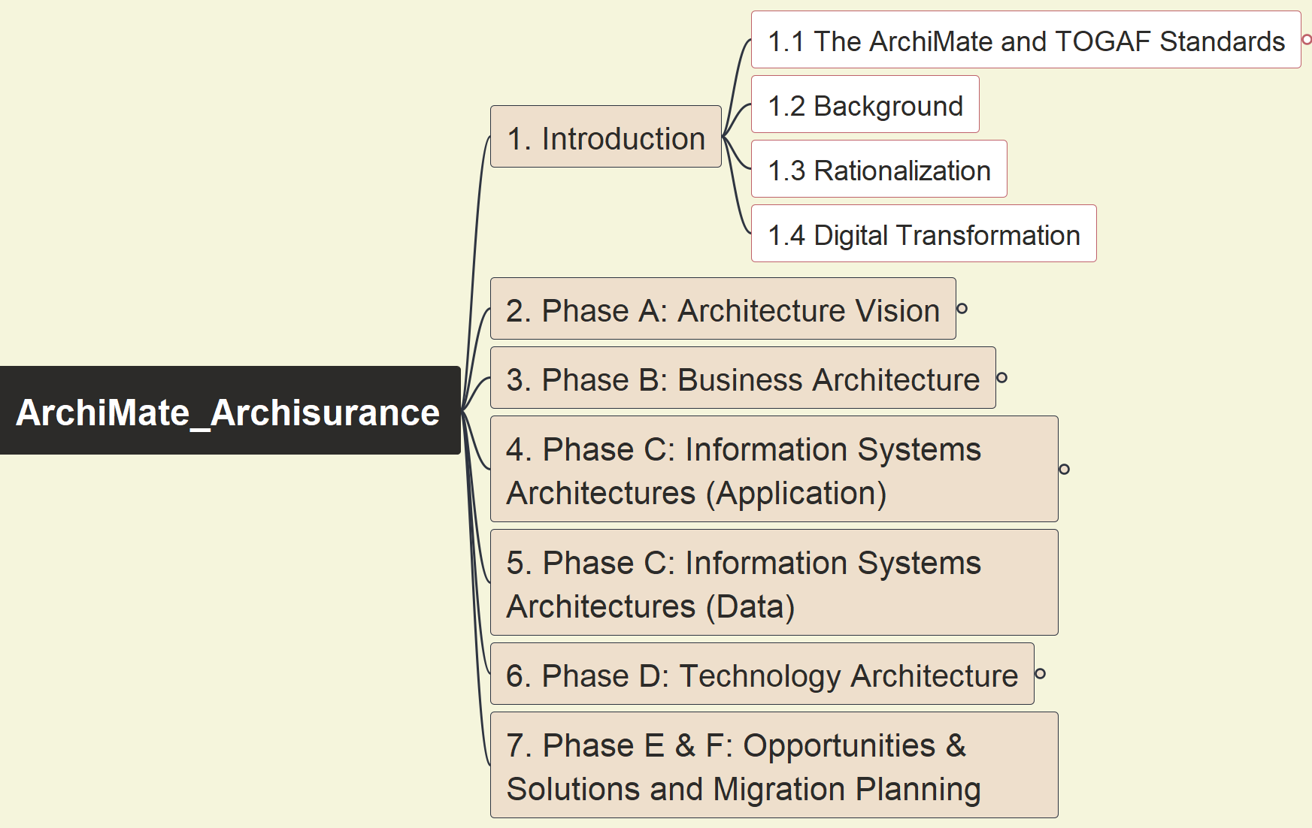
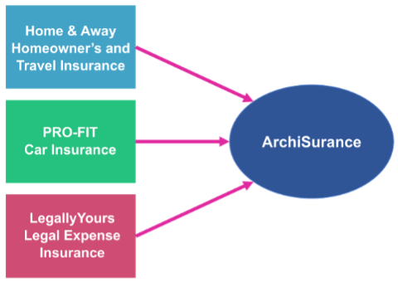
ArchiSurance Case Study Overview & Intro
ArchiSurance 2025
002

Slide 7
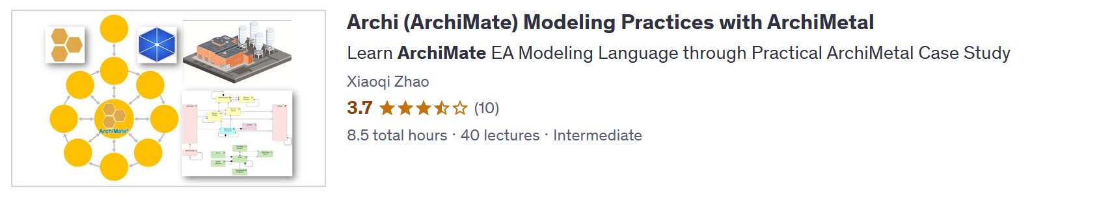
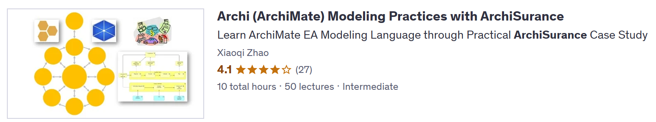
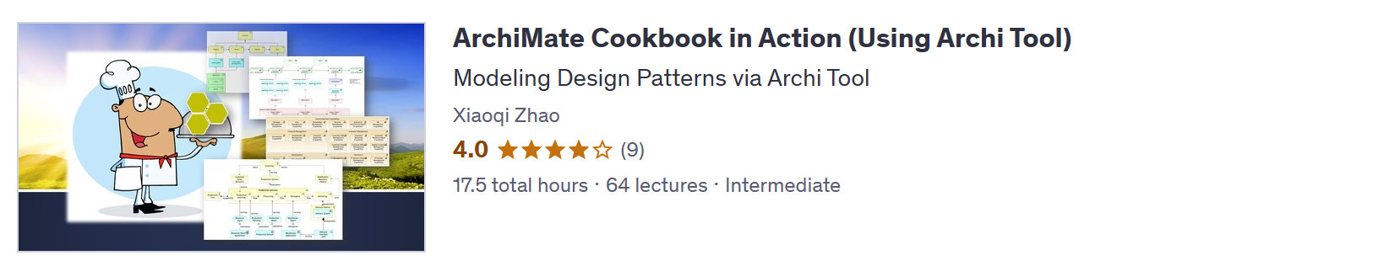
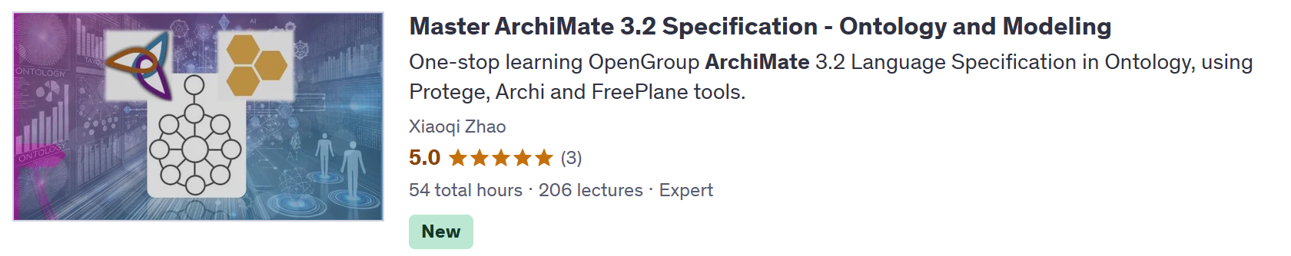
Check Other Related Course

Slide 8
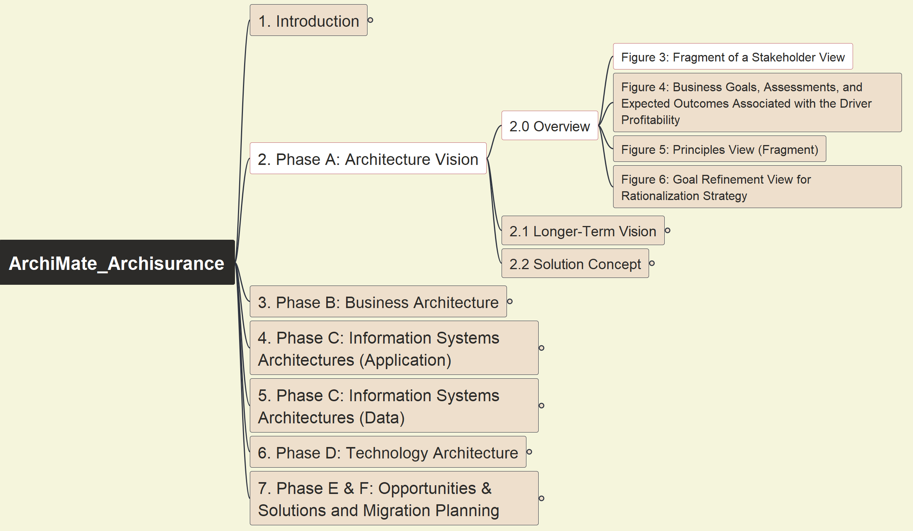
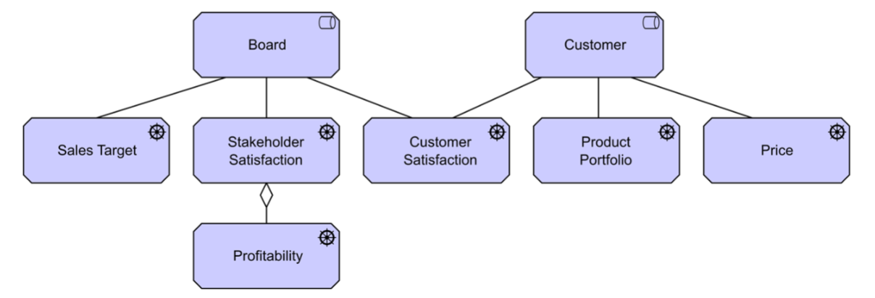
Phase A: Architecture Vision - Stakeholder View
ArchiSurance 2025
003

Slide 9
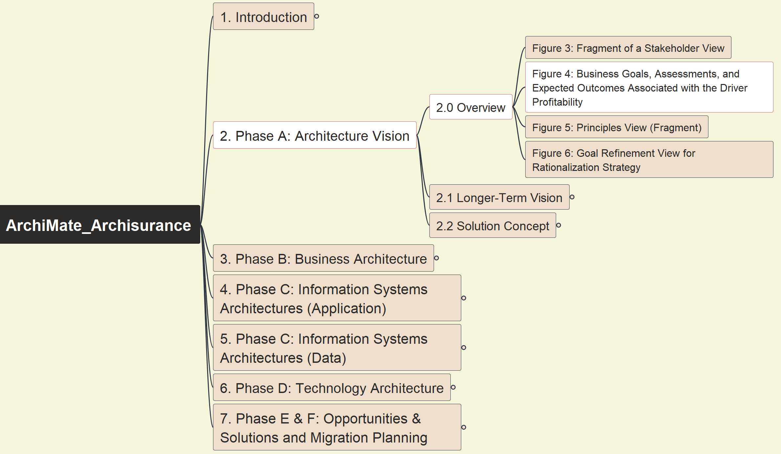
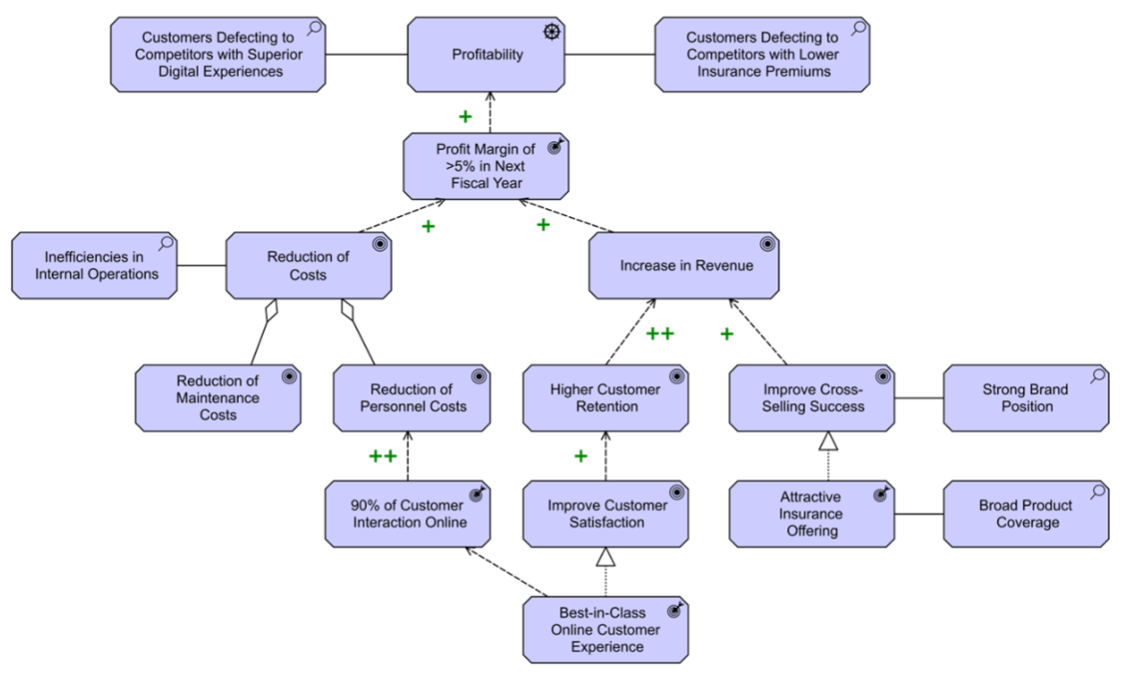
Phase A: Architecture Vision - Business Goals, Assessments, Outcomes
ArchiSurance 2025
004

Slide 10
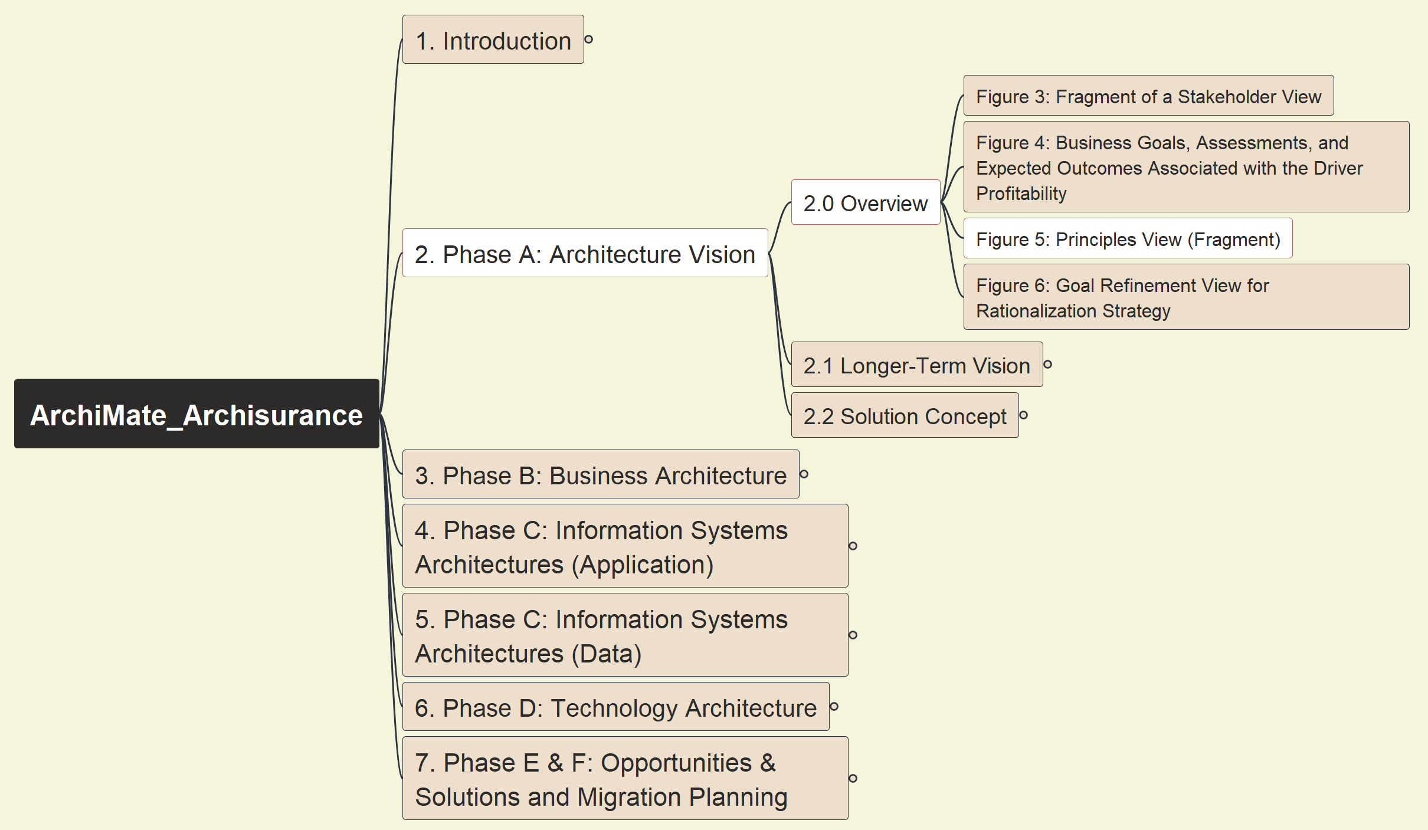
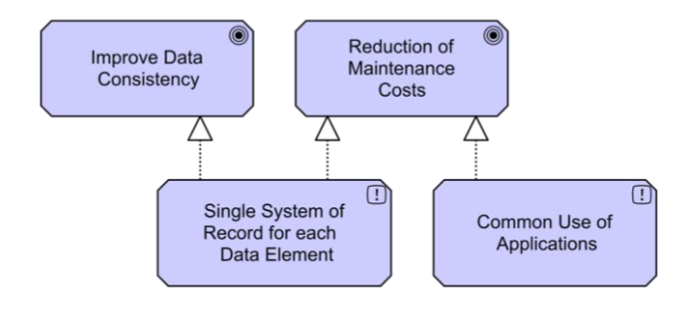
Phase A: Architecture Vision - Principles View
ArchiSurance 2025
005

Slide 11
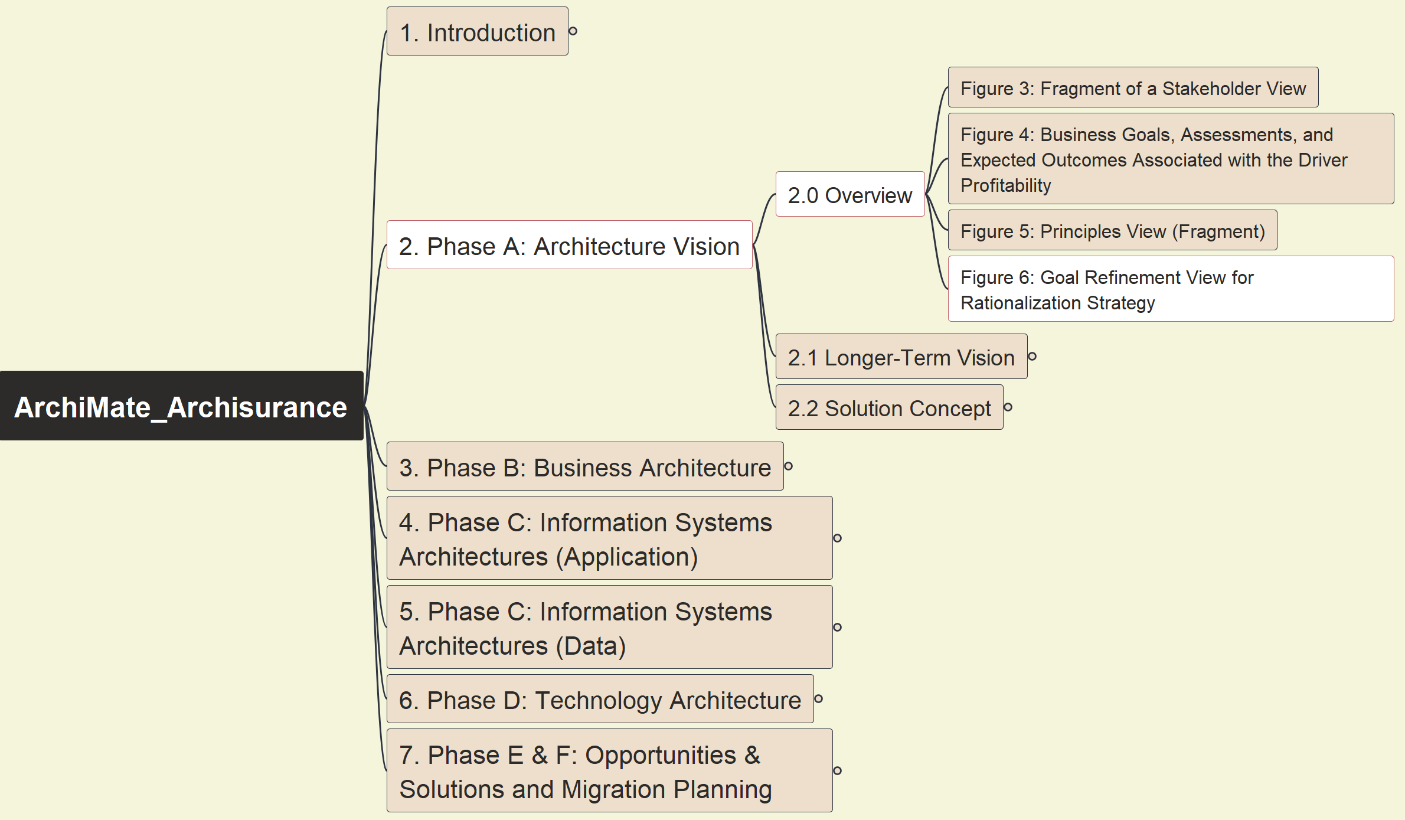
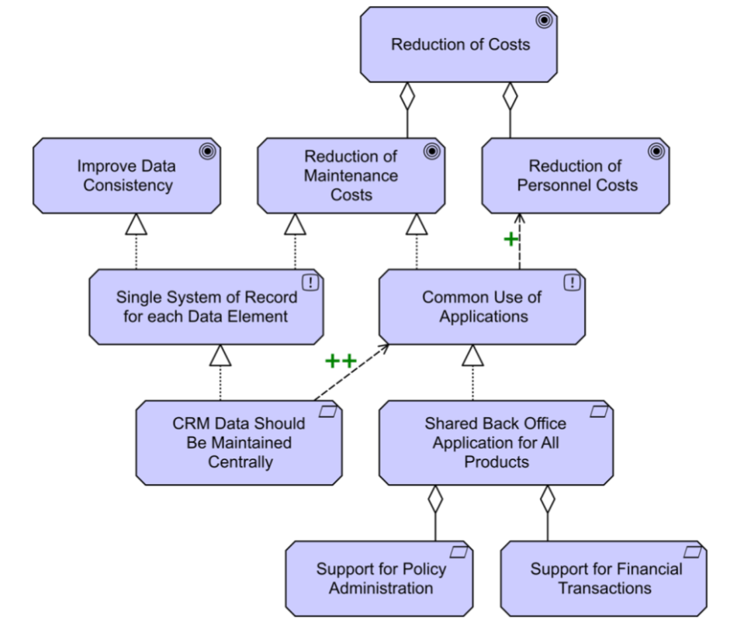
Phase A: Architecture Vision - Goal Refinement View for Rationalization Strategy
ArchiSurance 2025
006

Slide 12
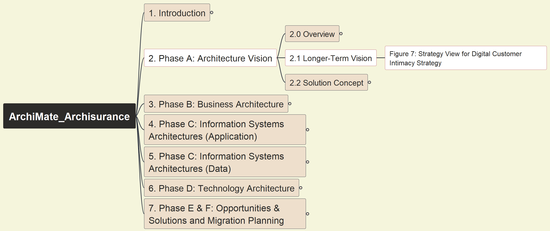
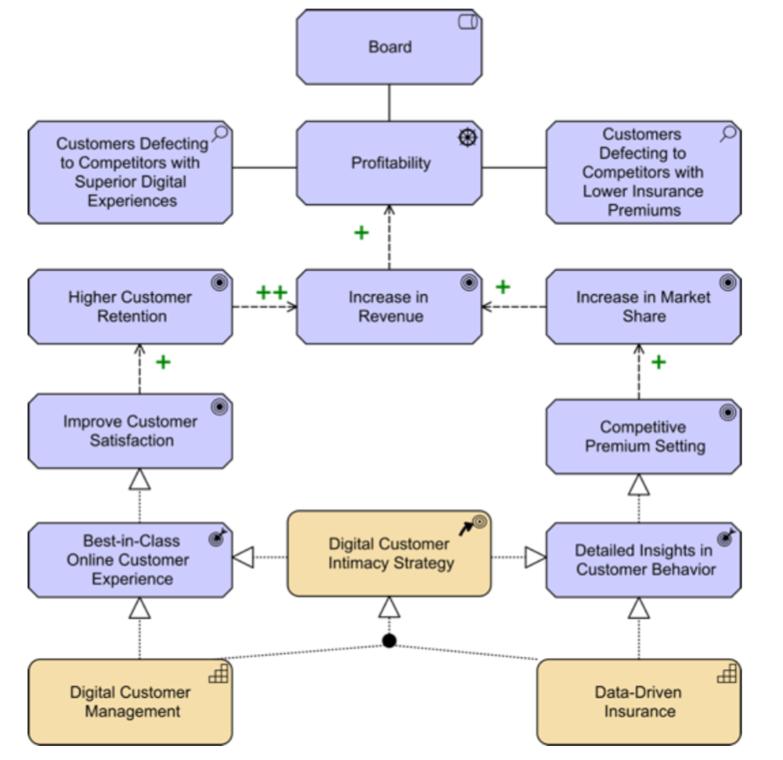
Phase A: Architecture Vision - Strategy View for Digital Customer Intimacy Strategy
ArchiSurance 2025
007

Slide 13
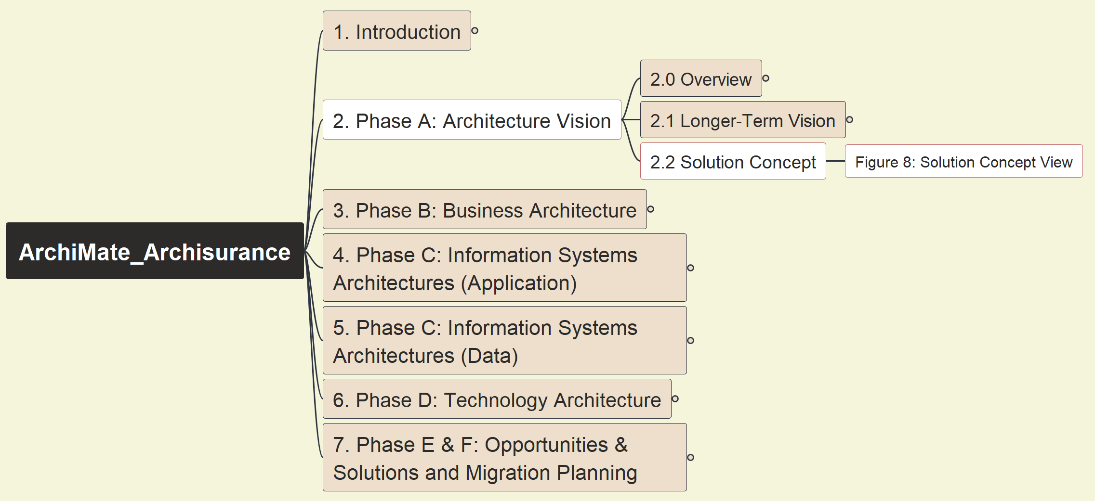
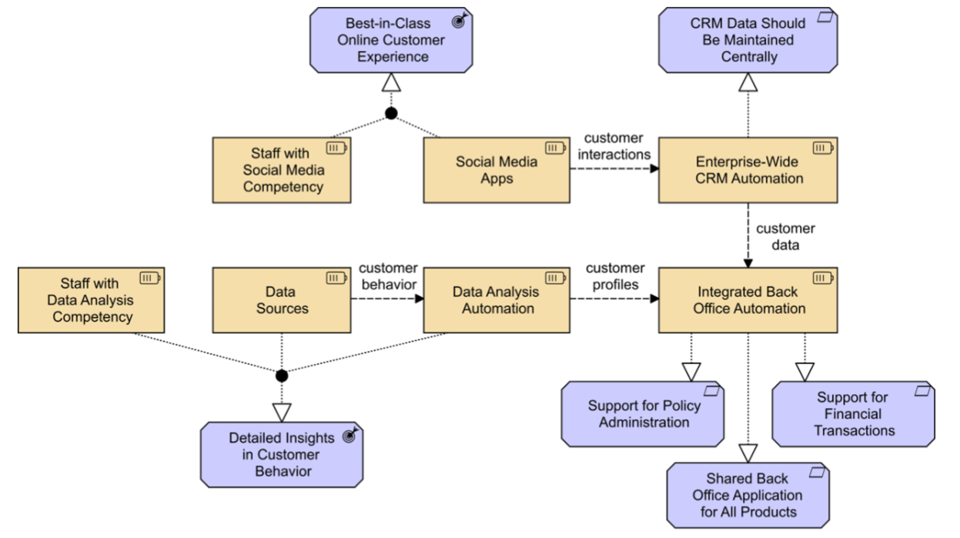
Phase A: Architecture Vision - Solution Concept View
ArchiSurance 2025
008

Slide 14
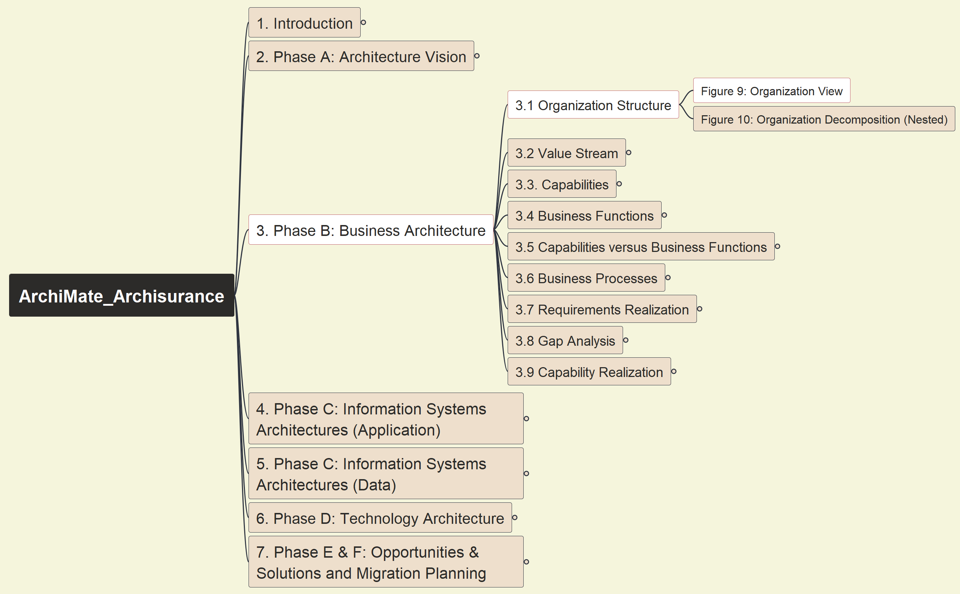
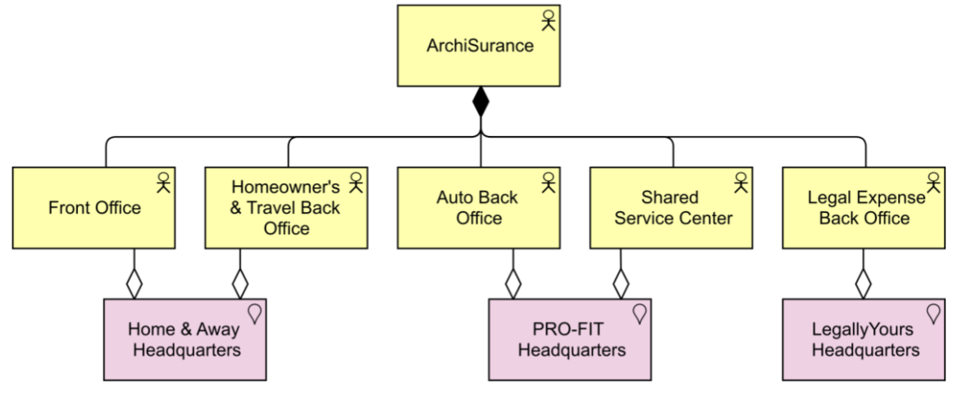
Phase B: Business Architecture - Organization View
ArchiSurance 2025
009

Slide 15


